Slide 1

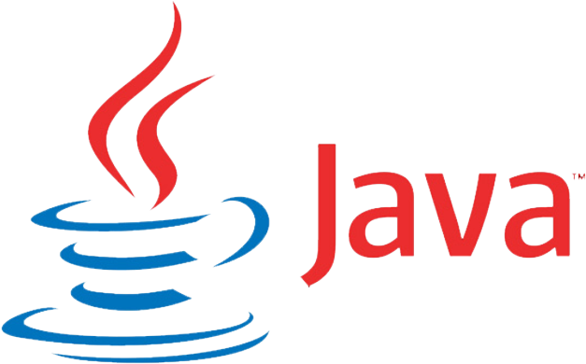
Application Launcher using Java
-by Shantanu Jain

Slide 2




Application Launcher
An application launcher is a computer program that helps a user to locate and start other computer programs. An application launcher provides shortcuts to computer programs, and stores the shortcuts in one place so they are easier to find.​

Slide 3

IDE: NetBeans
NetBeans is an integrated development environment for Java. NetBeans allows applications to be developed from a set of modular software components called modules.

Slide 4
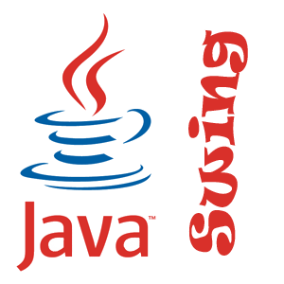
Java Swing
Swing is a GUI widget toolkit for Java. It is part of Oracle's Java Foundation Classes – an API for providing a graphical user interface for Java programs.

Slide 5
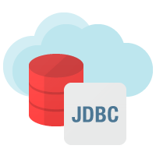
Java Database Connectivity(JDBC)
Java Database Connectivity is an application programming interface for the programming language Java, which defines how a client may access a database.

Slide 6
Calling an external program in JAVA
Java contains the functionality of initiating an external process – an executable file or an existing application on the system.
We use following classes for this purpose:
Process class
Runtime class

Slide 7
Straight to preview!

Slide 8
LOGIN FORM

Slide 11
LOGIN
SUCCESS

Slide 12
APPLICATION LAUNCHER

Slide 13
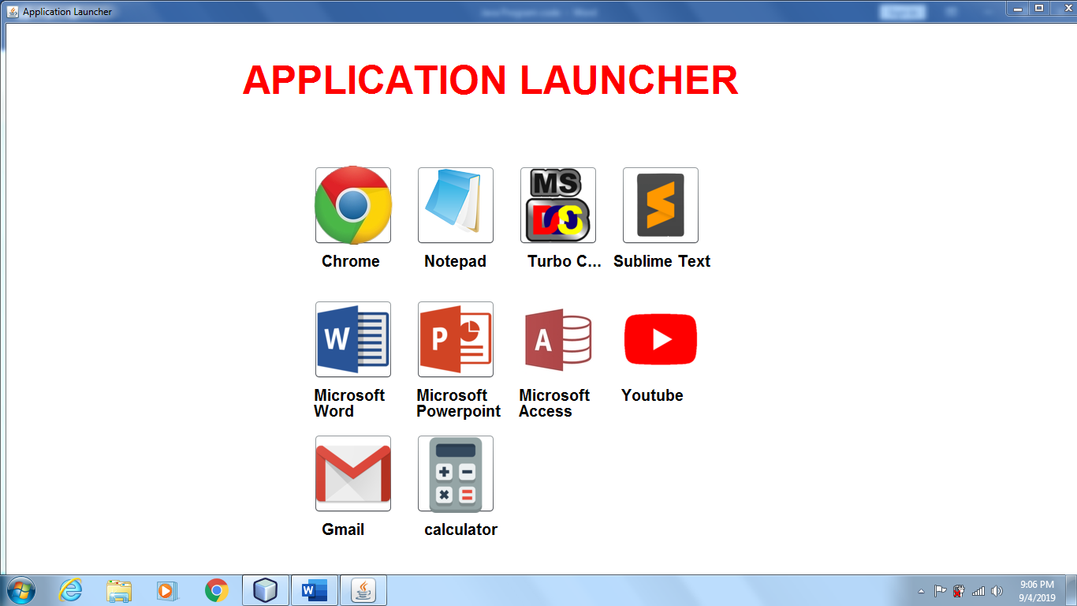

Slide 14
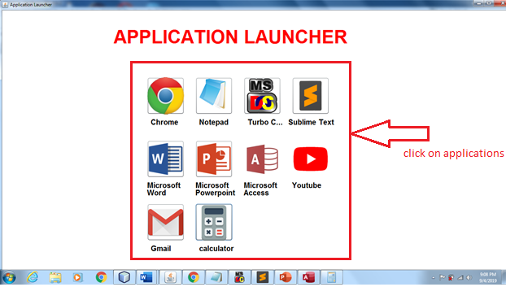

Slide 15
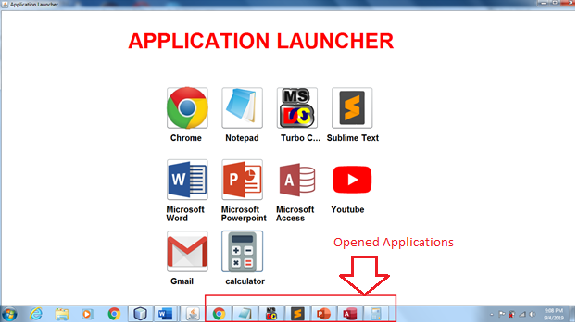

Slide 16
DATABASE

Slide 17
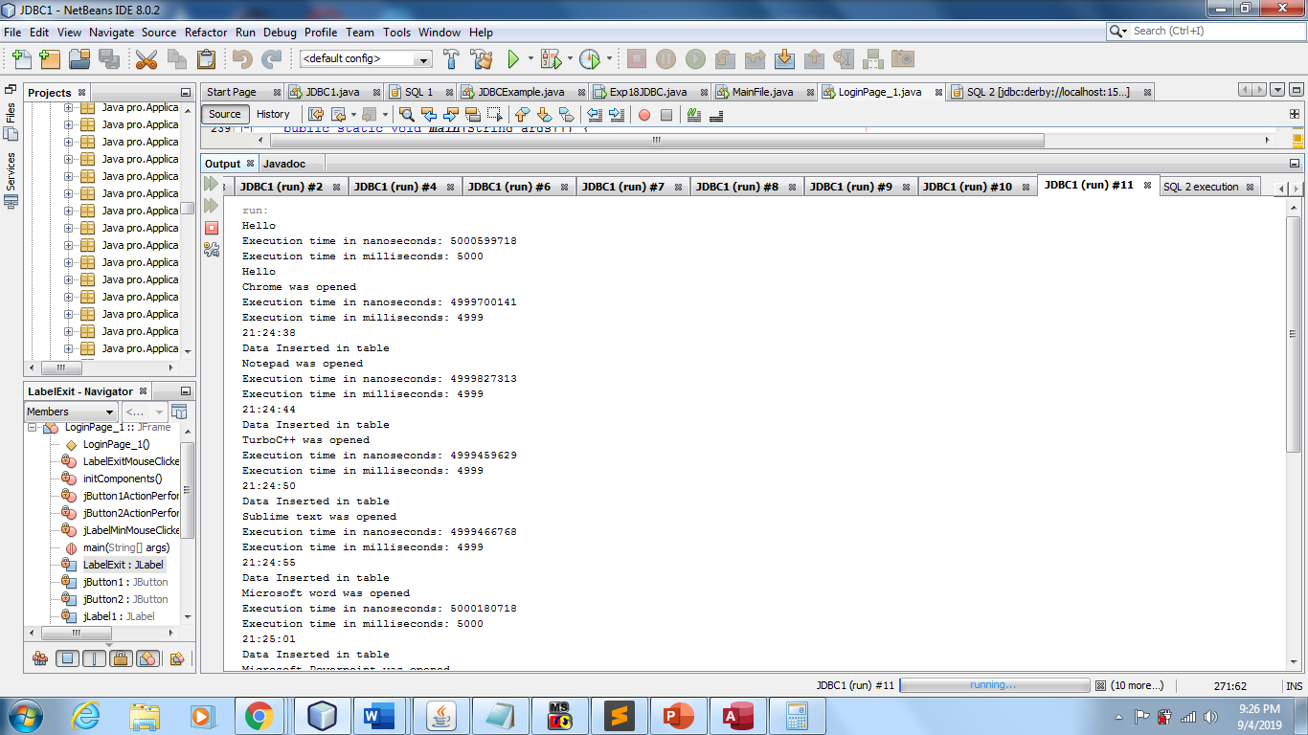

Slide 18
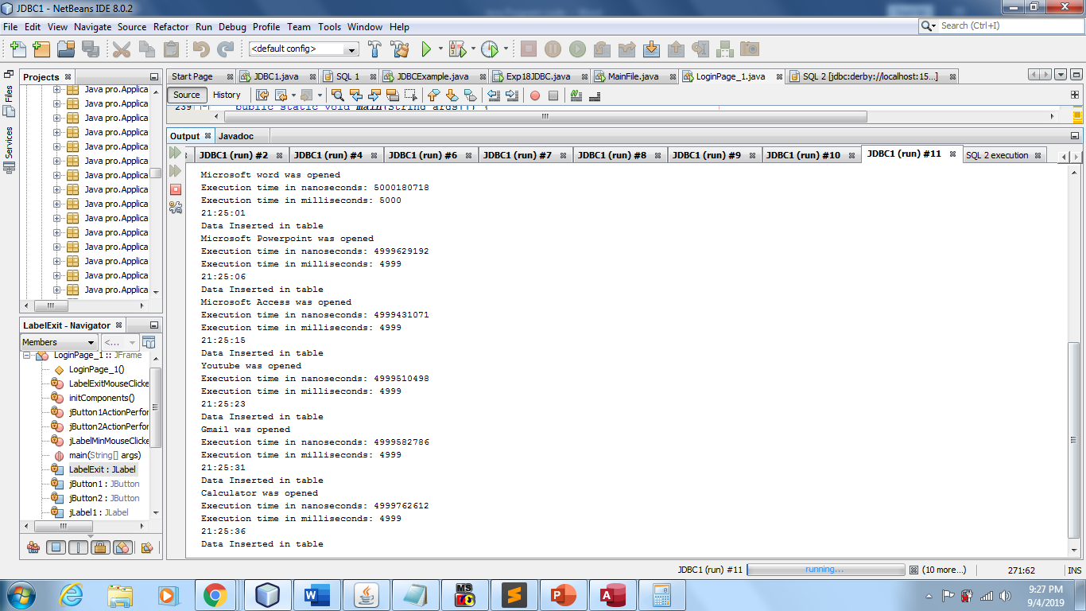

Slide 19
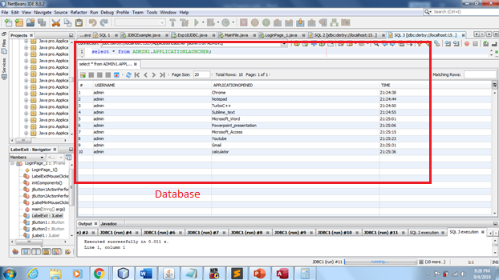

Slide 20
THANK YOU

